Slide 1
MODULE 17: FRACTURES
TCCC TIER 1
All Service Members
TCCC TIER 2
Combat Lifesaver
TCCC TIER 3
Combat Medic/Corpsman
TCCC TIER 4
Combat Paramedic/Provider

Slide 2





TACTICAL COMBAT CASUALTY CARE (TCCC) ROLE-BASED TRAINING SPECTRUM
ROLE 1 CARE
NONMEDICAL PERSONNEL
MEDICAL PERSONNEL
ASM
CMC
CPP
CLS
YOU ARE HERE
STANDARDIZED JOINT CURRICULUM
2

Slide 3
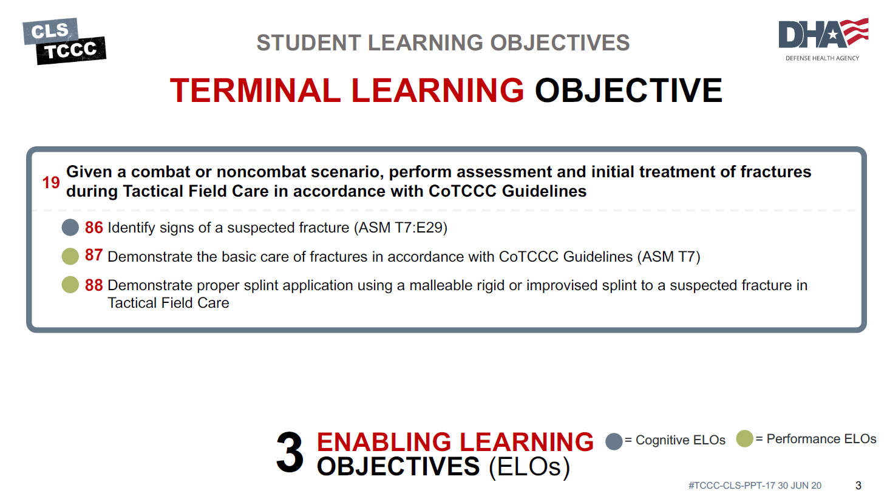




TERMINAL LEARNING OBJECTIVE
STUDENT LEARNING OBJECTIVES
₁₉ Given a combat or noncombat scenario, perform assessment and initial treatment of fractures during Tactical Field Care in accordance with CoTCCC Guidelines
Identify signs of a suspected fracture (ASM T7:E29)
Demonstrate the basic care of fractures in accordance with CoTCCC Guidelines (ASM T7)
Demonstrate proper splint application using a malleable rigid or improvised splint to a suspected fracture in Tactical Field Care
3
ENABLING LEARNING OBJECTIVES (ELOs)
= Cognitive ELOs
= Performance ELOs
3

Slide 4


Three PHASES of TCCC
TACTICAL FIELD CARE
1 CARE UNDER FIRE
RETURN FIRE AND TAKE COVER
Quick decision-making:
▪ Consider scene safety
▪ Identify and control life- threatening bleeding
▪ Move casualty to safety
TACTICAL FIELD CARE
COVER AND CONCEALMENT
₃ TACTICAL EVACUATION CARE
More deliberate assessment and treatment of unrecognized
life-threatening injuries
▪ Pre-evacuation procedures
▪ Continuation of documentation
NOTE: This is covered in more advanced TCCC training!
2
Basic management plan:
Maintain tactical situational awareness
Triage casualties as required
Conduct MARCH PAWS
assessment
▪
▪
YOU ARE HERE
4
#TCCC-CLS-PPT-14 30 JUN 20

Slide 5
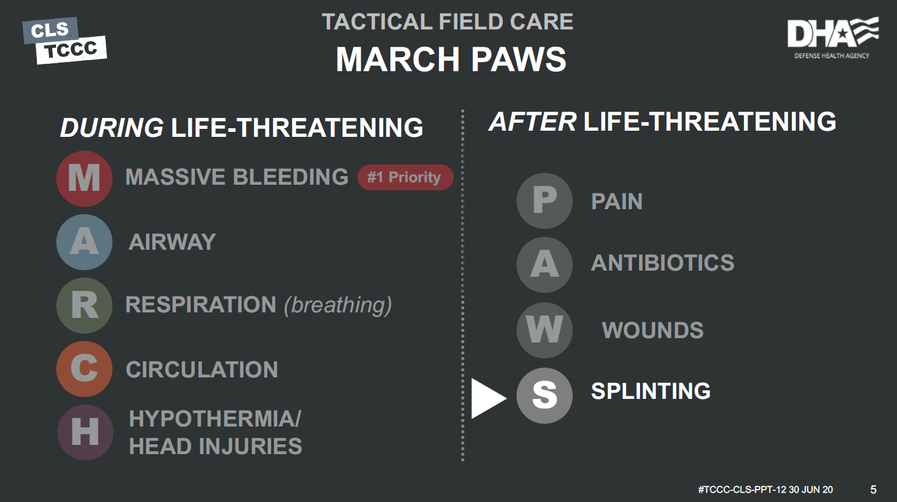
MARCH PAWS
TACTICAL FIELD CARE
DURING LIFE-THREATENING
AFTER LIFE-THREATENING
M A R C H
MASSIVE BLEEDING
P A W
#1 Priority
PAIN
AIRWAY
ANTIBIOTICS
RESPIRATION (breathing)
WOUNDS
CIRCULATION
S
SPLINTING
HYPOTHERMIA/ HEAD INJURIES
5

Slide 6

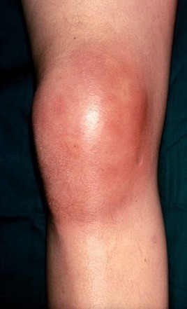
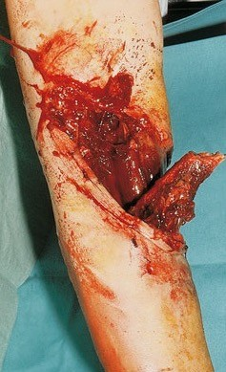
FRACTURES
ASSESS FOR A FRACTURE
WARNING SIGNS OF A FRACTURE:
Significant pain and swelling An audible or perceived “snap”
Different length or shape of limb
Loss of pulse or sensation in the injured arm or leg
Crepitus (hearing a crackling or popping sound under the skin)
CLOSED FRACTURE
No open wound (break in skin) for closed fracture
OPEN FRACTURE
Open fracture open wound (break in skin) major threat for infection
6

Slide 7
FRACTURES
OBJECTIVES OF SPLINTING
A splint is used to prevent movement and hold an injured arm/leg in place to:
1
Identify the location of the fracture
NOTE: Have the casualty or someone else manually stabilize the area
Check the distal pulse (pulse below the fracture) and capillary refill (color returning to the nail bed after pressing on it) on the injured extremity before applying the splint
Prepare the splint materials for application
NOTE: Measure and shape the splint on the opposing uninjured extremity
Prepare securing materials (cravats, elastic wraps/bandages, etc.)
Apply the splint to the injured extremity with the limb, in the position of function (a normal resting position), if possible
NOTE: If possible, lightly pad all voids within the splint to make it more comfortable
Secure the splint in place with appropriate materials
2
3
4
5
6
7
Ensure the joints above and below the fracture are immobilized in the splint whenever possible
Recheck the distal pulse following application of the splint. If the pulse is not palpable, loosen the splint, reposition, and reapply the splint
Administer the pain medications (from the Combat Wound Medication Pack) as needed and the antibiotic for any open fracture(s)
Document all treatment on a DD FORM 1380 TCCC Casualty Card and attach it to the casualty
#TCCC-CLS-PPT-17 30 JUN 20
8
9
10
7

Slide 8
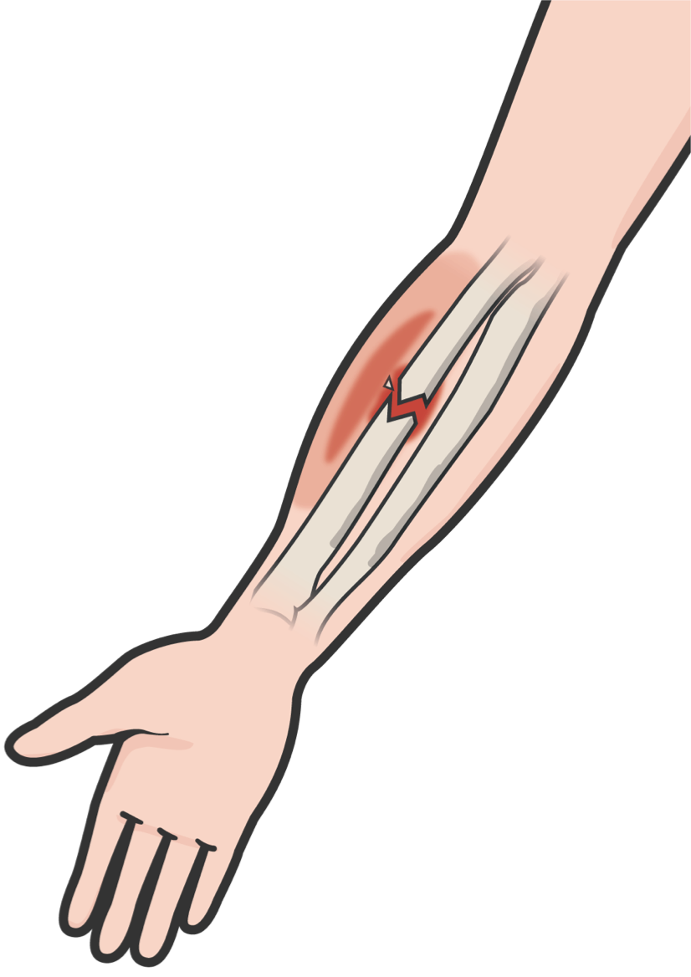
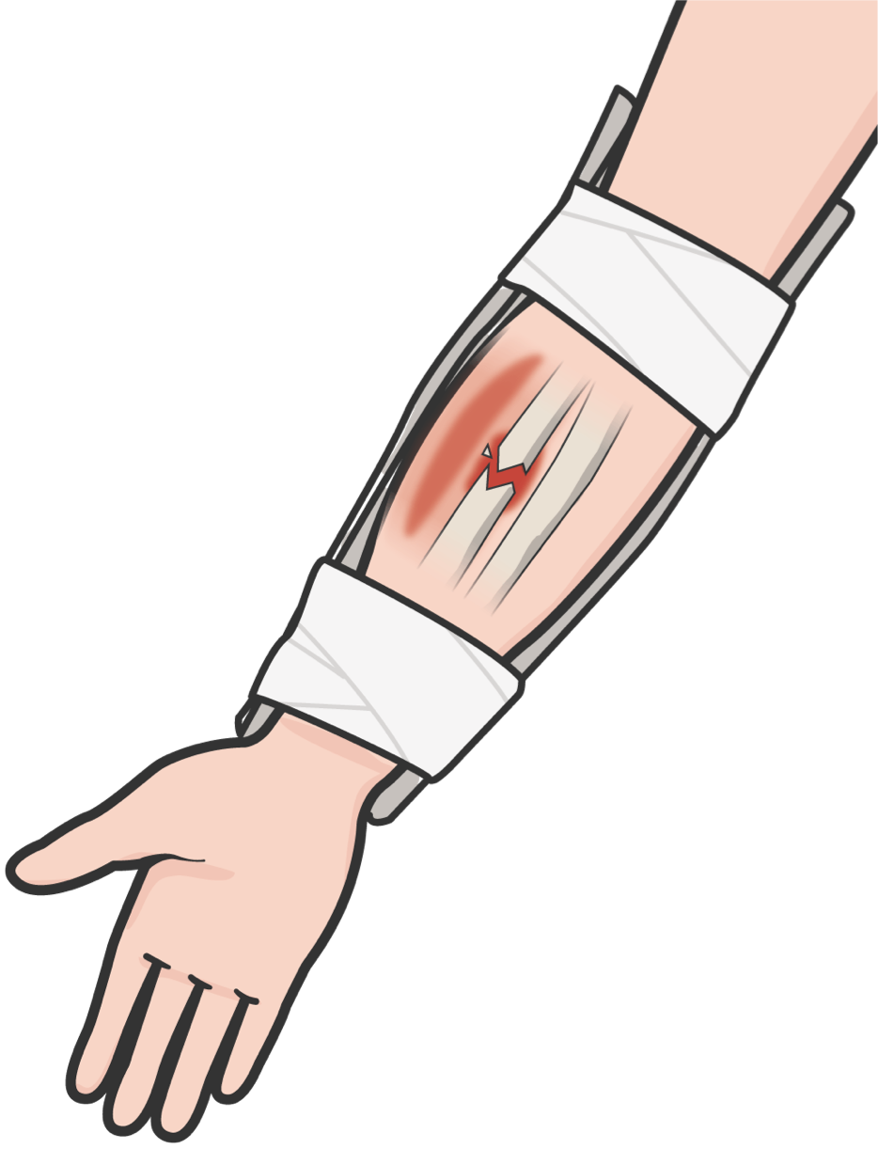
FRACTURES
PRINCIPLES OF SPLINTING
Check for other associated injuries Use malleable or rigid materials
Try to pad all voids or wrap if using rigid splint
Secure splint with elastic bandage, cravats, belts, tape Try to splint before moving the casualty
Minimize manipulation of the extremity before splinting Incorporate one joint above and below the fracture
Splint arm fractures to the shirt using the sleeve, if needed Check distal pulse and skin color before and after splinting
8

Slide 9

FRACTURES
THINGS TO AVOID WHEN SPLINTING
Manipulating the fracture site too much resulting in pain, additional damage to blood vessels and nerves, etc.
Securing too tightly, cutting off blood flow
Failing to immobilize joint above and below fracture when possible Causing further injury
Making casualty uncomfortable during transport/evacuation Splinting near or over a wound that has not be properly treated
9

Slide 10
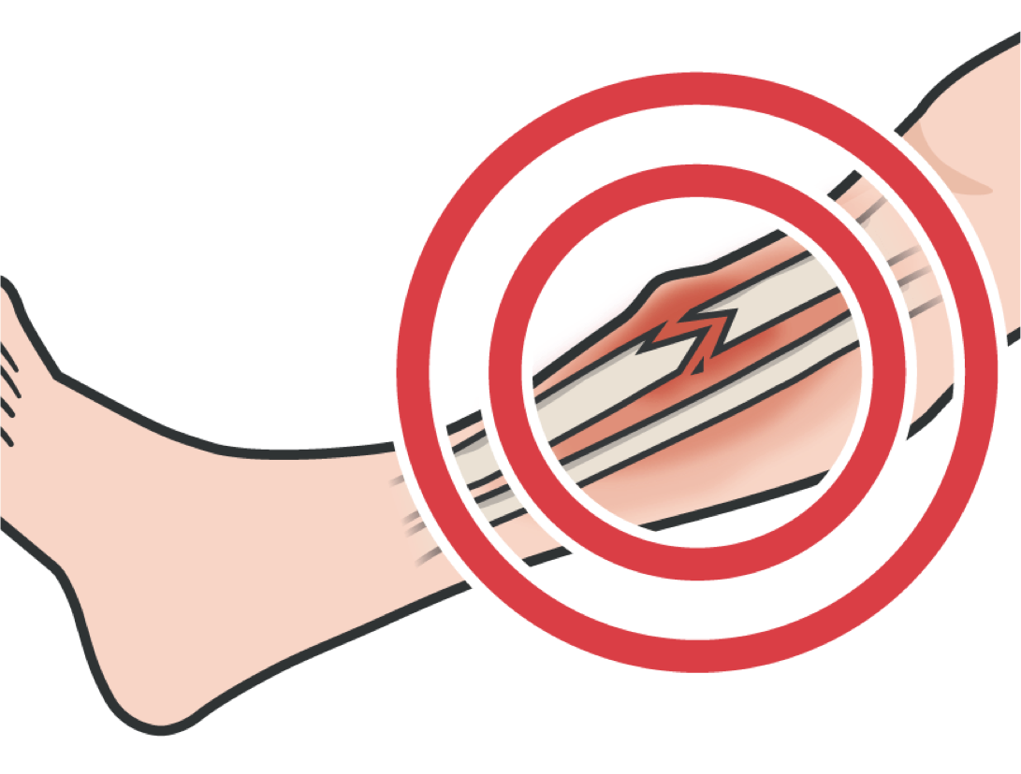
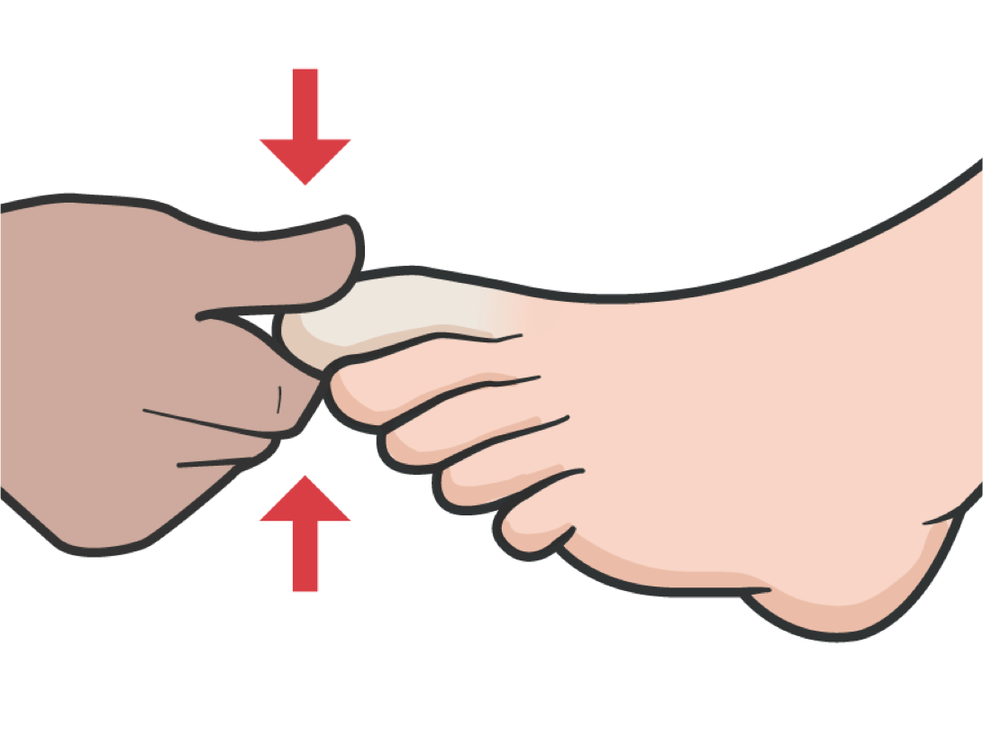
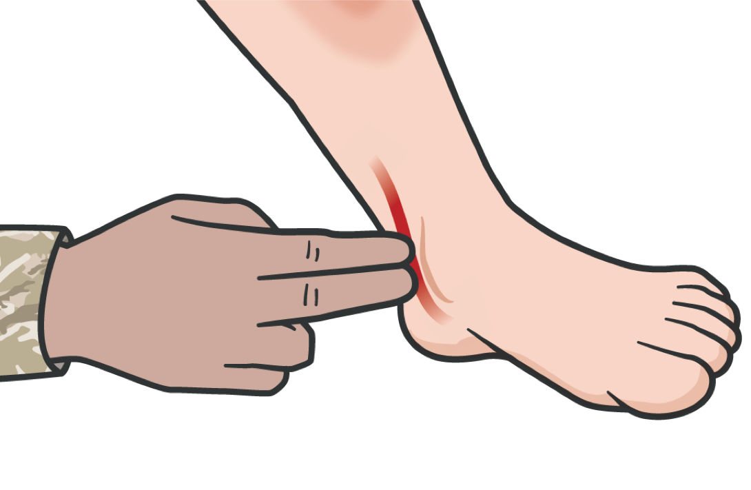

SPLINTING
GUIDELINES FOR LEG SPLINTS
Identify the location of the fracture
Before applying the splint, CHECK distal pulse (pulse below the fracture)
CHECK capillary refill (color returning to the nail bed after pressing on it) on the injured extremity before applying the splint
Have the casualty or someone else manually stabilize the area
10

Slide 11
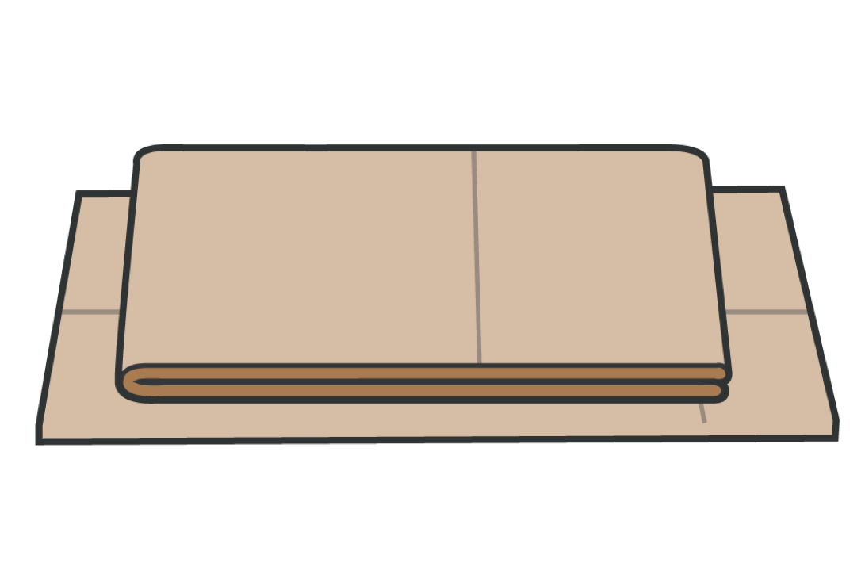
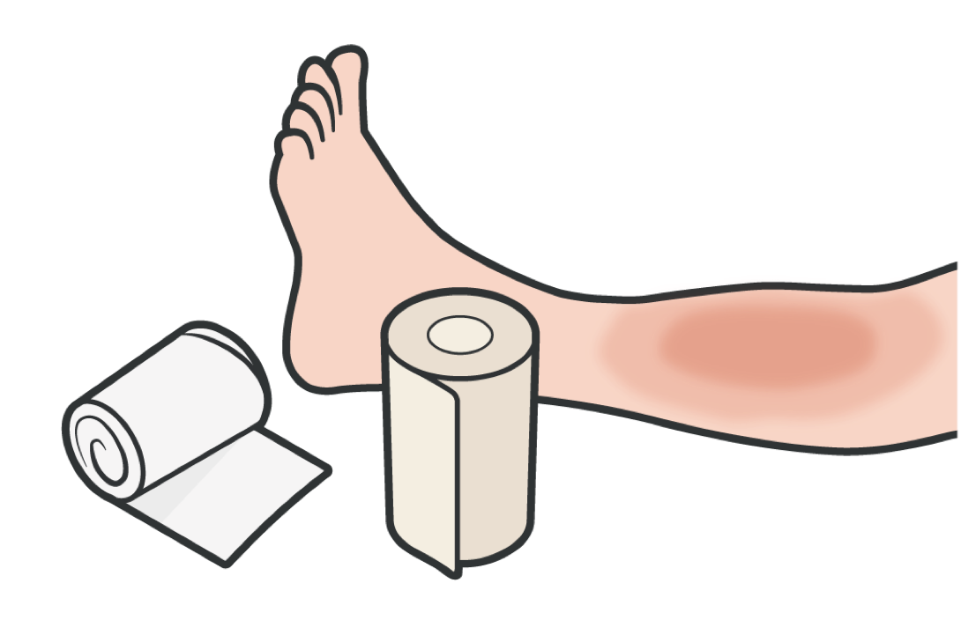
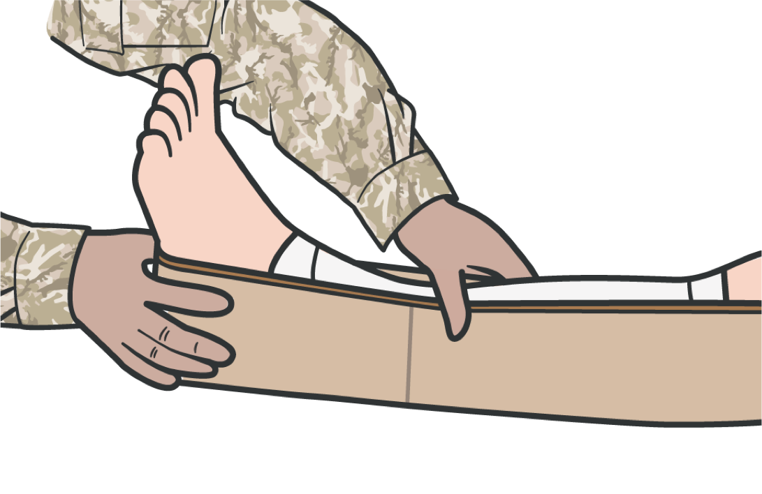
SPLINTING
GUIDELINES FOR LEG SPLINTS
PREPARE the splint materials for application
PREPARE securing materials (cravats, elastic wraps/ bandages, etc.)
APPLY the splint to the injured extremity with the limb, in the position of function, a normal resting position, if possible
Measure and shape the splint on the opposing uninjured extremity

Slide 12
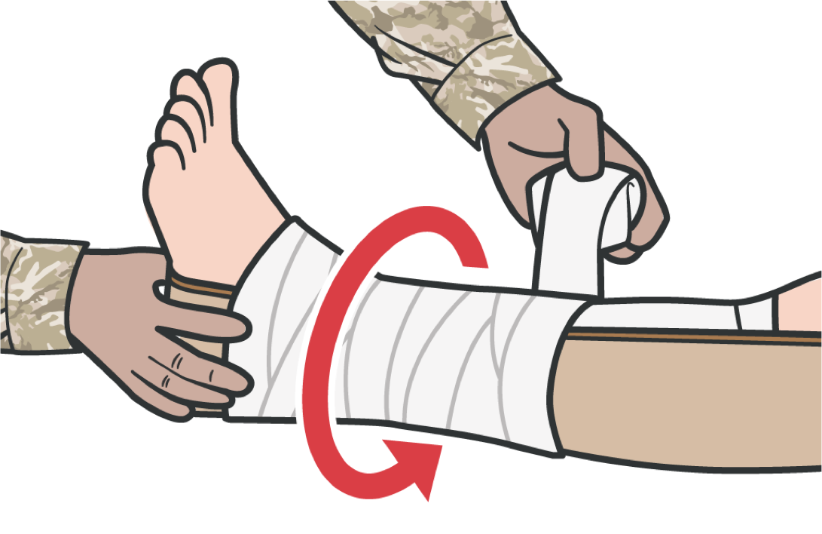
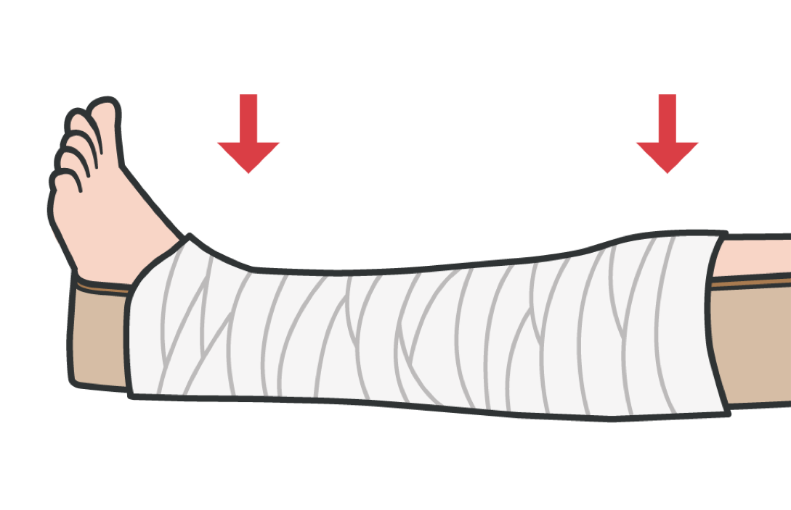
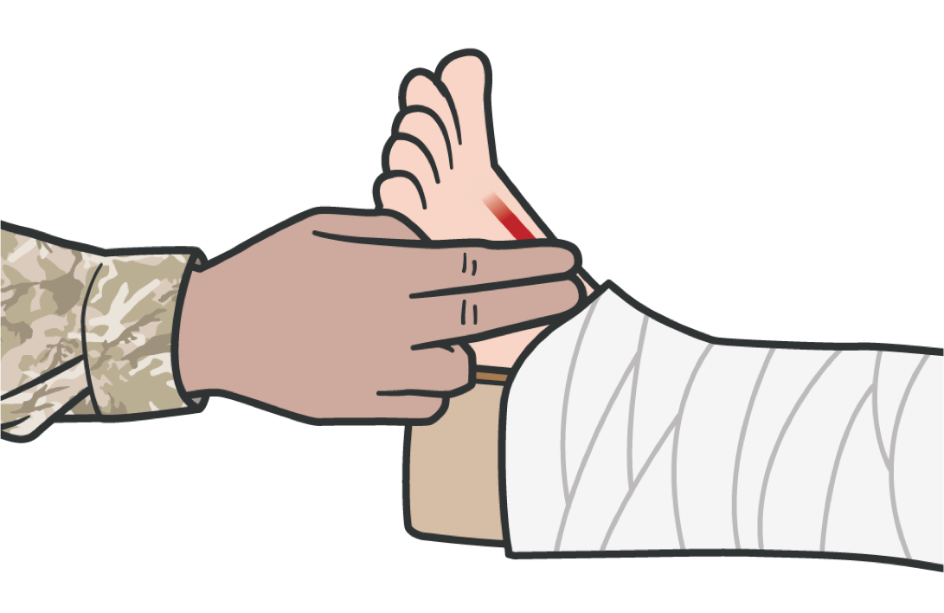
SPLINTING
GUIDELINES FOR LEG SPLINTS
SECURE the splint in place with appropriate materials
ENSURE the joints above and below the fracture are immobilized in the splint whenever possible
RECHECK the distal pulse following application of
the splint
If the pulse is not palpable, loosen the splint, reposition, and reapply

Slide 13
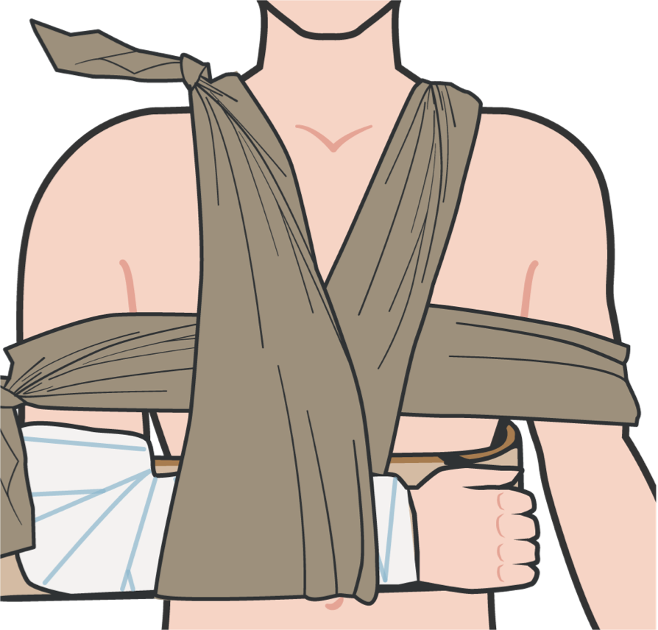
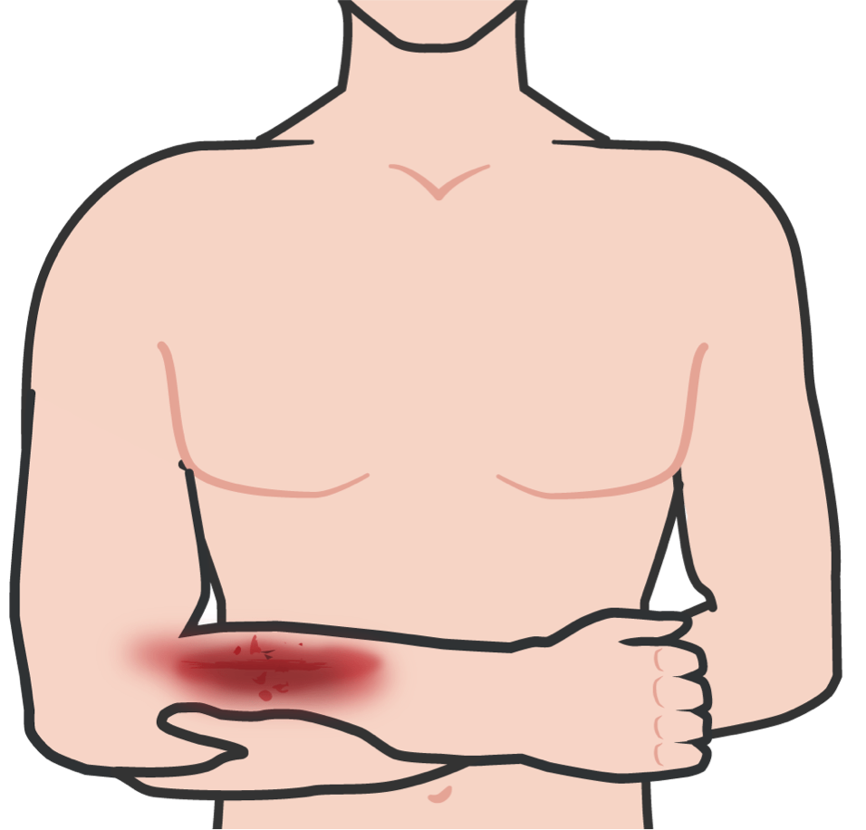
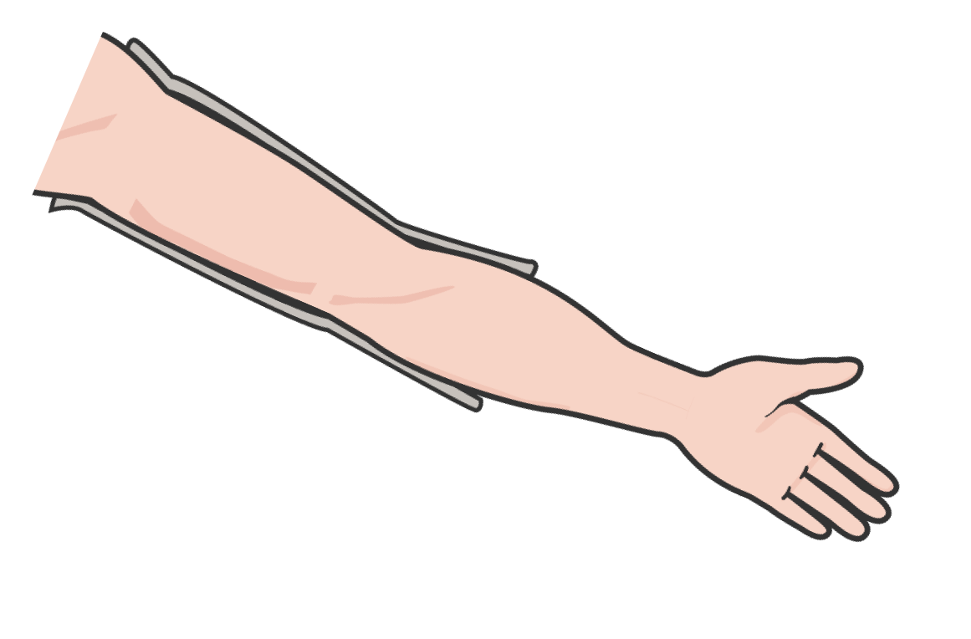
GUIDELINES FOR ARM SPLINTS
SPLINTING
Splinting the arm is the same concept as splinting a leg with the following exceptions:
Use two triangular bandages to secure limb to body
Use third triangular bandage; place under injured arm and around neck to help support injured limb
If possible, have casualty support their injury while preparing equipment
Mold padded splint using casualty’s unaffected limb

Slide 14
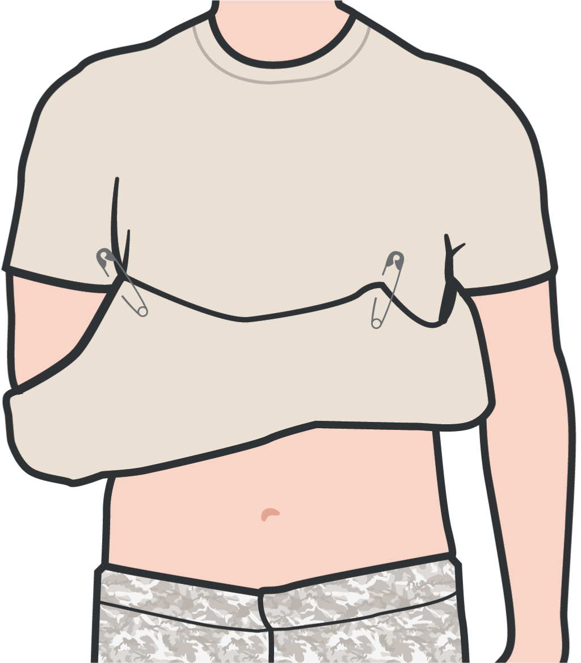
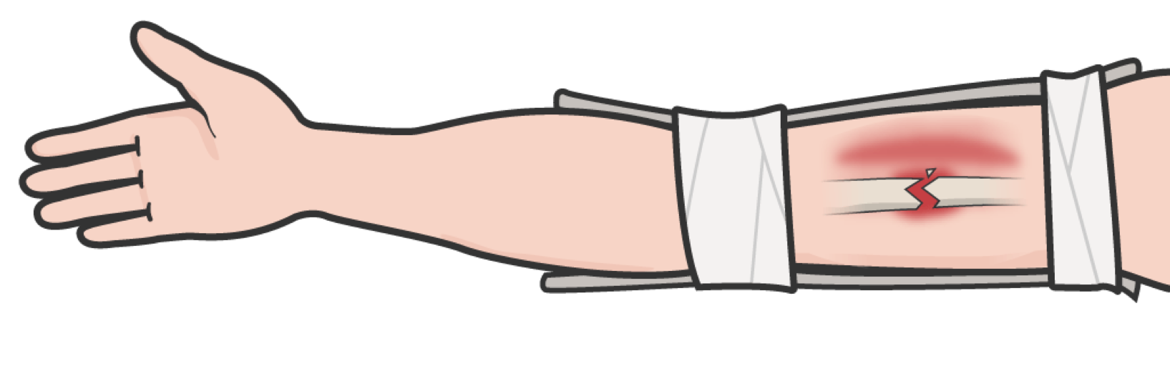
SPLINTING
GUIDELINES FOR ARM SPLINTS
Apply a swathe to immobilize the upper arm
Place two cravats above the fracture site and two below the fracture site (preferred)
Check for signs of impaired circulation Apply a sling to immobilize the forearm

Slide 15


SPLINTING
SPLINTING AN ARM

Slide 16
SPLINTING
SKILL STATION
Splinting (Skill) Splinting

Slide 17
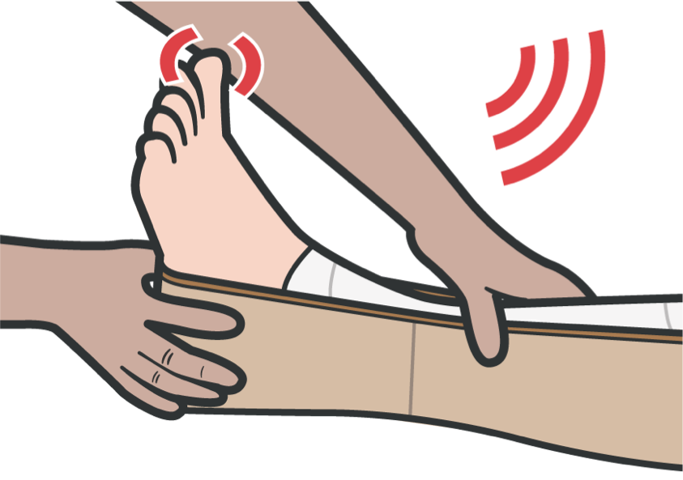
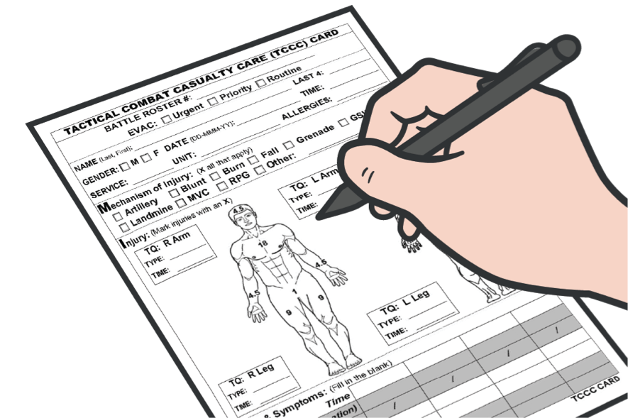
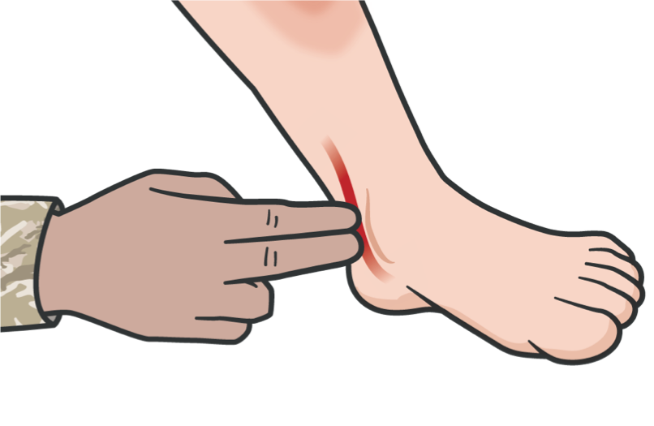

FRACTURES
SUMMARY
The most important aspect of splinting is to splint in a way that does not harm the nerves or blood vessels in the splinted extremity
Before and after splinting, assess the following:
CIRCULATION
Check pulses distal to the splint (between splint and end of limb)
MOTOR
Ask the casualty to move the body parts distal to the splint, e.g.,
fingers or toes
SENSORY
See if the casualty can feel a gentle touch on the body parts distal to the splint
AFTER SPLINTING
Document all assessment and treatment on the casualty’s DD Form 1380

Slide 18
FRACTURES
CHECK ON LEARNING
True or False: When applying a splint, ensure the joints above and below the fracture are immobilized in the splint whenever possible.
What should you assess before and after splinting?

Slide 19
FRACTURES
ANY QUESTIONS?

